Slide 1
Students&Companies
Authors: Pica Mirko Pianalto Riccardo Prendin Christian

Slide 2
RASD Requirements Analysis and
Specification Document

Slide 3
Goals
G1
Allow companies to post their internship opportunities
G2
Allow students to search for available internship
G3
Notify students when an internship that might be of interest to them is posted
G6
Collect feedback from student and companies to improve the matchmaking process
G7
Provide suggestion for companies to improve internship descriptions and for students to improve their resume

Slide 4
Boundaries
World phenomena
WP6 The Company wants to accept a student for an internship
WP11 The University wants to handle complaints
WP13 The Student wants to respond to questionnaires
Shared phenomena
SP7 The Company sets the topics for the internship
SP21 The Company contacts a student for an internship
SP44 S&C collect feedback and suggestions from Students

Slide 5
Domain assumption
D1
The ST personal information must be correct.
D6
The ST need to be currently enrolled in a UV.
D7
The UV and CP must have an active partnership with S&C.

Slide 6
Requirements
R5
The system shall allow CPs to post new internship opportunities, including position details, required skills, duration, and compensation.
R6
The system shall allow STs to apply for internships by submitting a CV and optional cover letter.
R11
The system shall allow UVs to manage their students and monitor their activity.
R17
The system shall recommend internships to STs based on their skills, preferences, and past applications.
R20
The system shall maintain a database of all internships, applications, and evaluations.

Slide 7
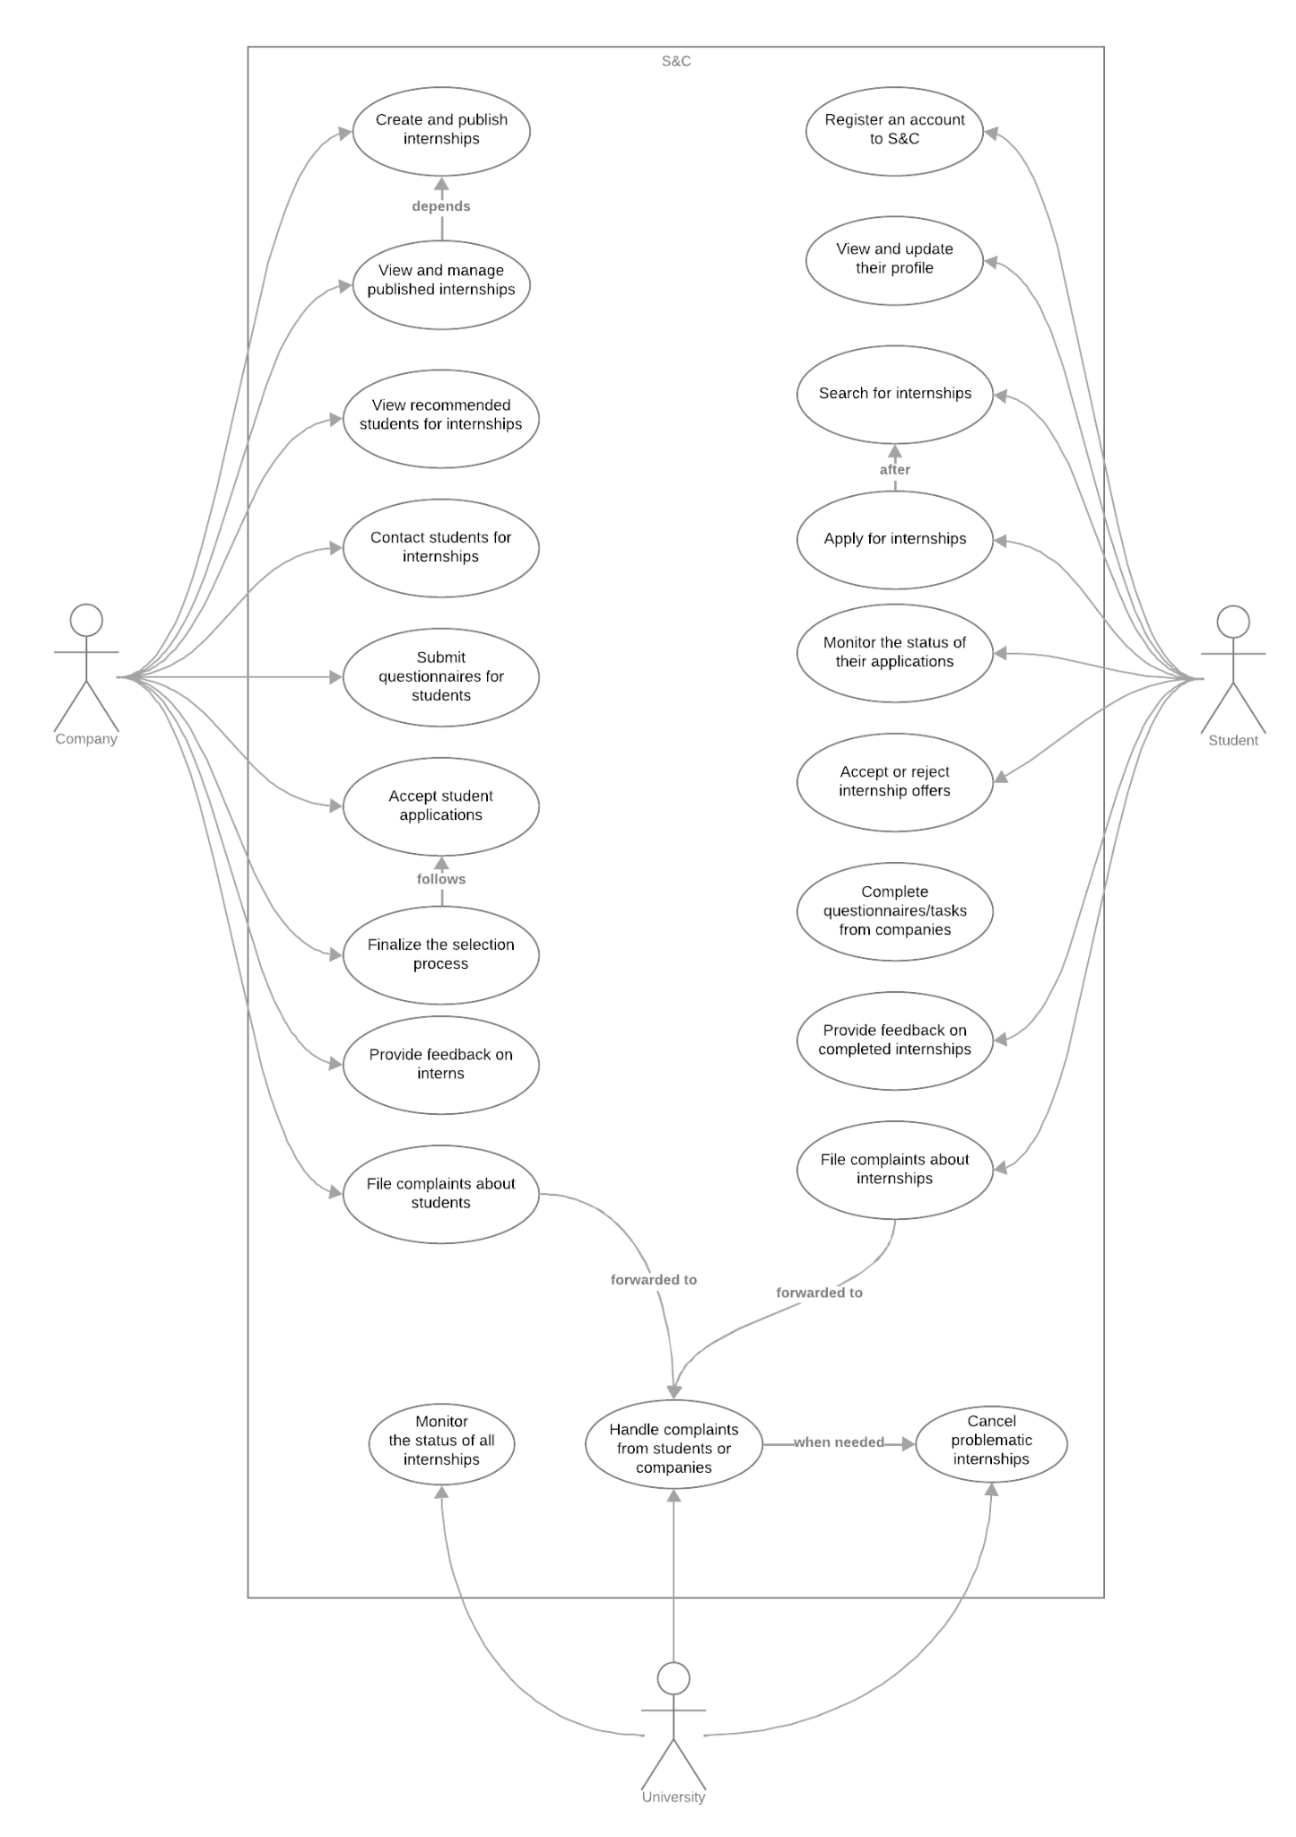
Use case diagram
Company
Student
University

Slide 8
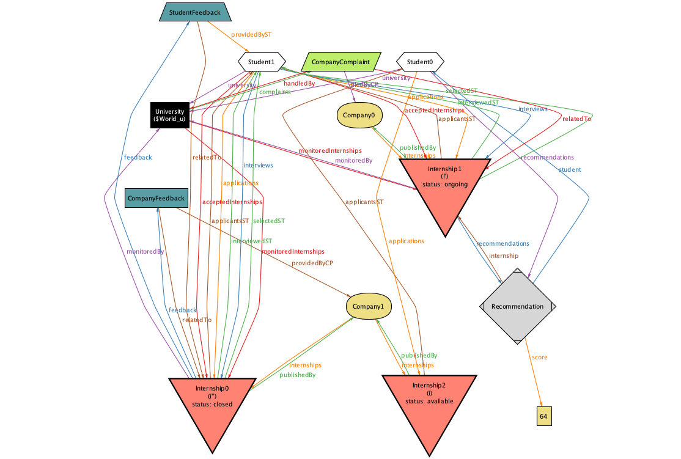
Alloy

Slide 9
DD Design Document

Slide 10
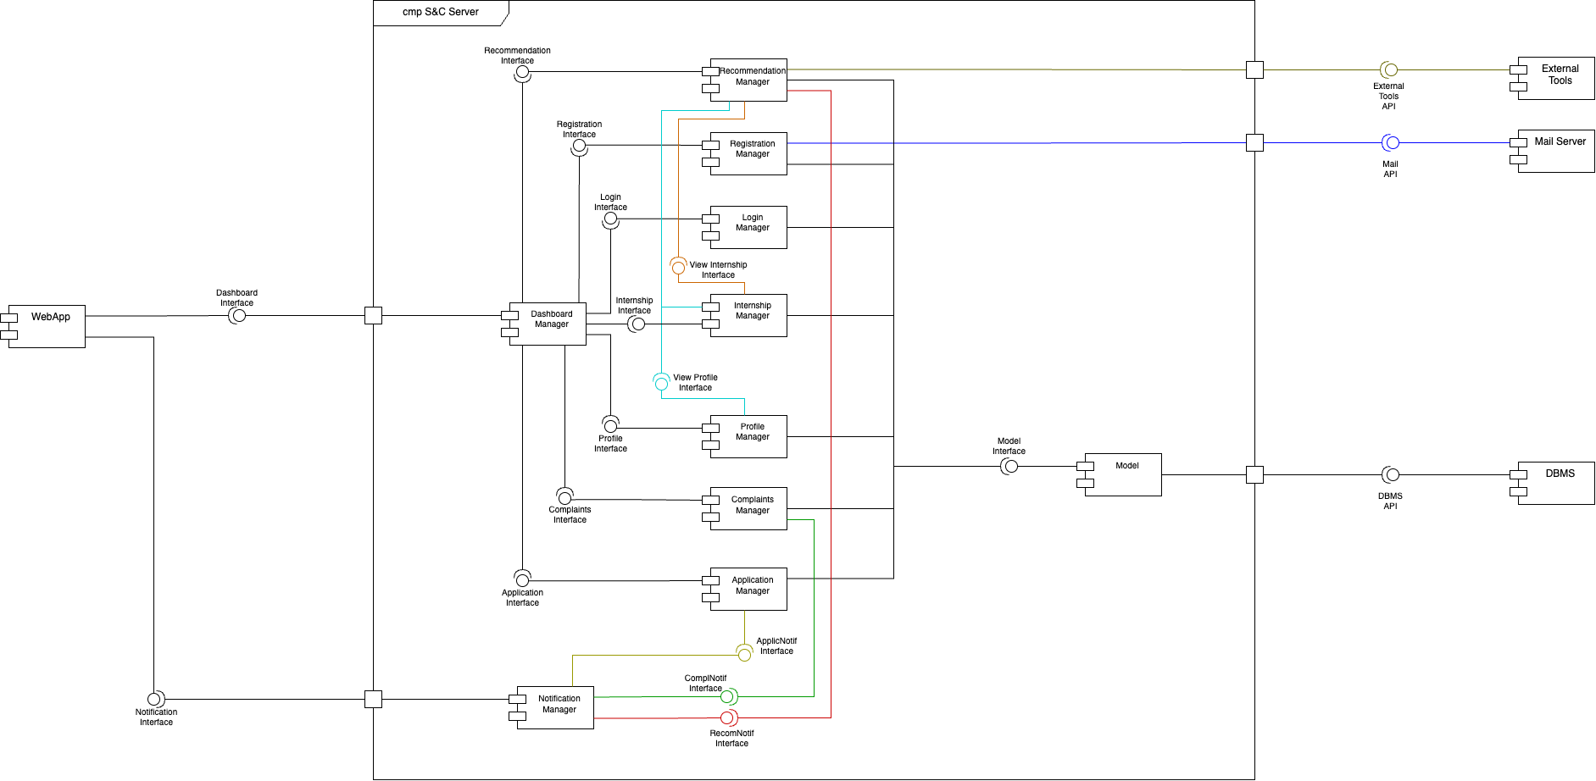
Components

Slide 11
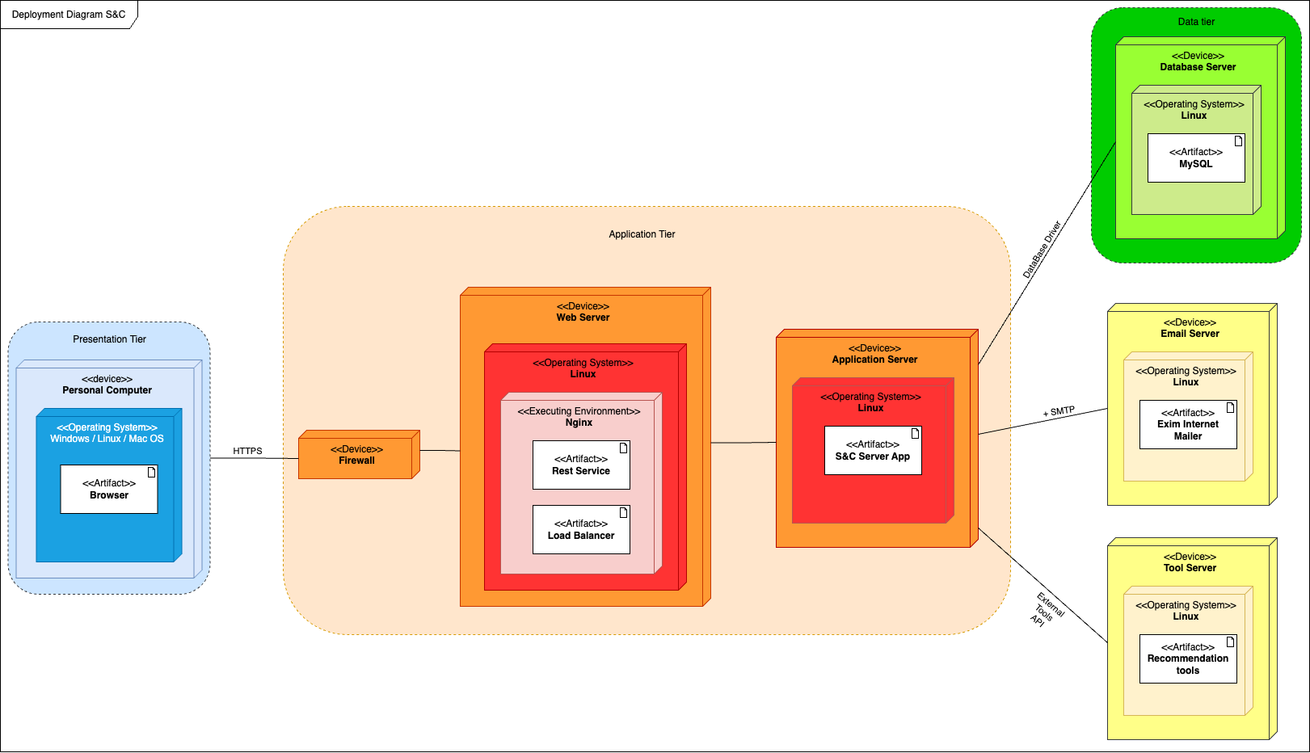
Architectural Styles And Paradigms
3-tier architecture
Model-View-Controller
APIs

Slide 12
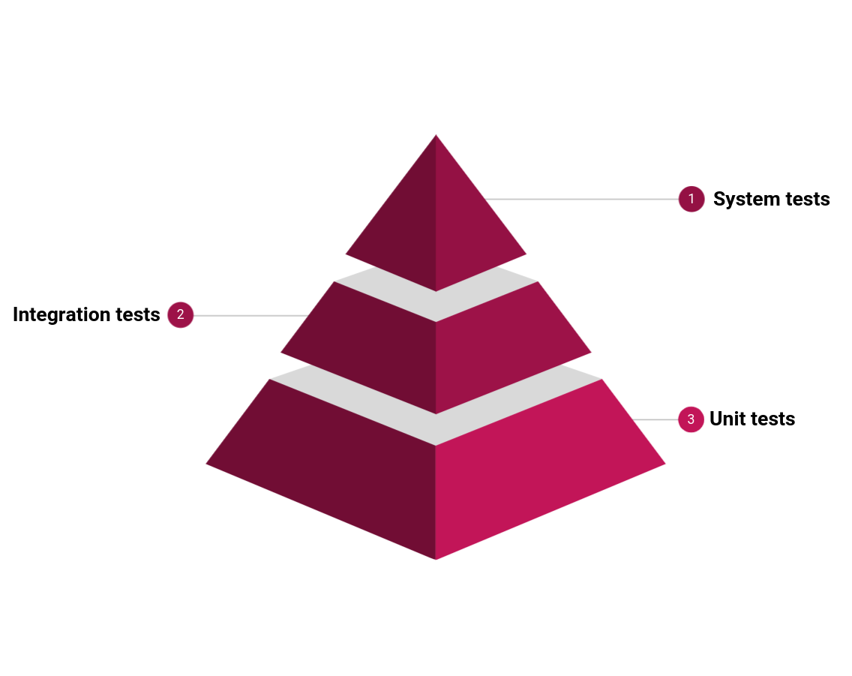
Implementation, Integration And Testing
Combination of two approaches:
Bottom-up strategy
Thread-based strategy
Essential modules first, then new features in parallel to speed up development. After all modules are integrated, system testing:
Functional
Load
Performance
Usability
Security

